Slide 1

Mountain Car
Capstone Project Example
Juan Vergara - MS

Slide 2
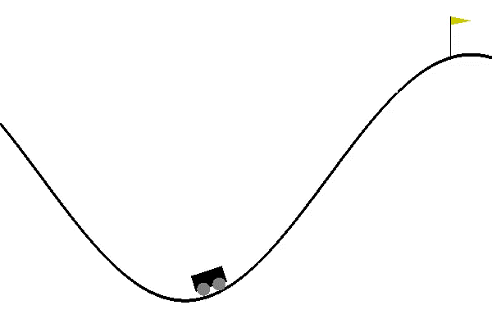
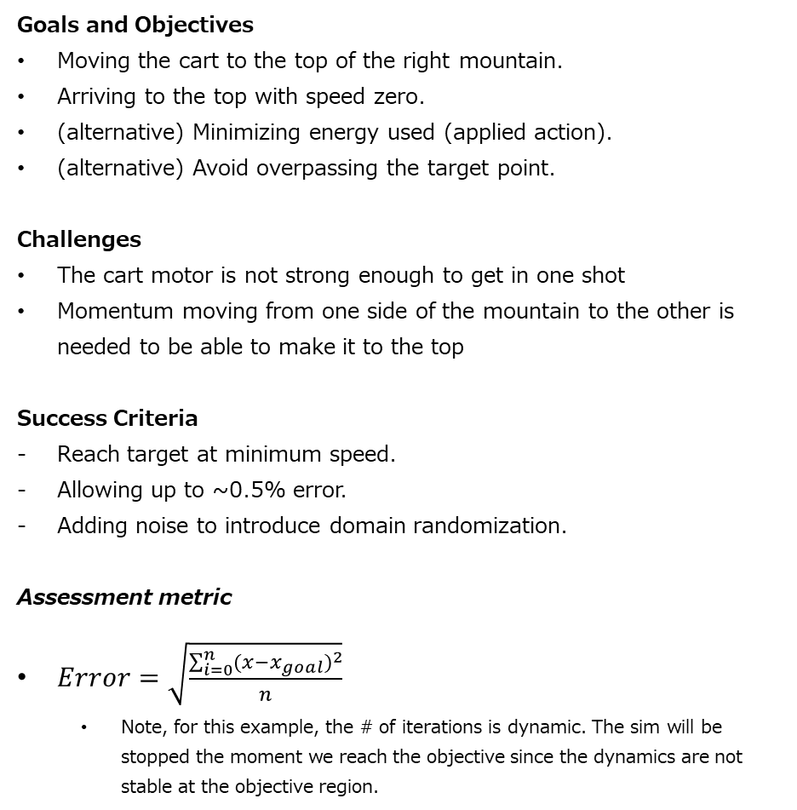
PROBLEM DEFINITION
Simulation
The simulation is the MountainCarContinuous-v0 gym environment, that runs on python. [ Gym Mountain Car Link ]
Problem Statement
“A car is on a one-dimensional track, positioned between two "mountains". The goal is to drive up the mountain on the right; however, the car's engine is not strong enough to scale the mountain in a single pass. Therefore, the only way to succeed is to drive back and forth to build up momentum.”
Goals and Objectives
Moving the cart to the top of the right mountain.
Arriving to the top with speed zero.
(alternative) Minimizing energy used (applied action).
(alternative) Avoid overpassing the target point.
Challenges
The cart motor is not strong enough to get in one shot
Momentum moving from one side of the mountain to the other is needed to be able to make it to the top
Success Criteria
Reach target at minimum speed.
Allowing up to ~0.5% error.
Adding noise to introduce domain randomization.
Assessment metric
$Error=\sqrt{\frac{\sum_{i=0}^{n}{{(x−x_{goal})}^{2}}}{n}}$
Note, for this example, the # of iterations is dynamic. The sim will be stopped the moment we reach the objective since the dynamics are not stable at the objective region.

Slide 3
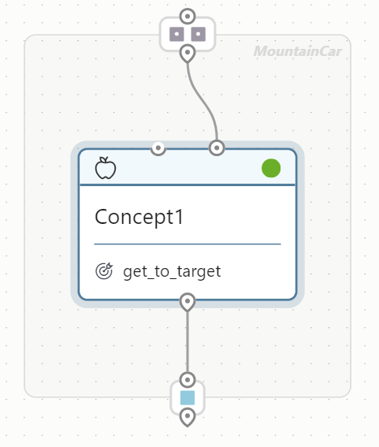
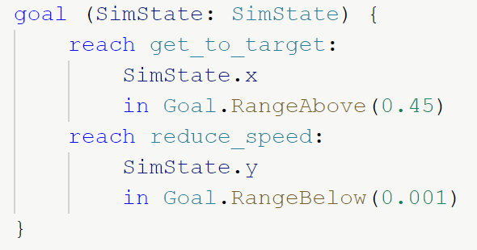
MAIN SPECS (Monolithic Brain)
Summary
Since the map is static, the Mountain Car problem doesn’t include the y position. The Markov Decision Property is respected. Also, the power to apply to the cart is described at a single continuous variable. Negative is left, and positive is right.
Constraints
The position of the cart must be limited to [-1, 0.55] if exceeded.
The action slope is NOT constrained -- We can move from max power to the left, to max power to the right.
Goals/Rewards
REACH/MINIMIZE ( abs(x – x_goal) == 0 )
REACH/MINIMIZE ( abs(x_vel – x_vel_goal) == 0 )
(alternative) MINIMIZE ( abs(action_command) )
STATES | Description | Range
x | Horizontal position of the cart | [-1, 0.55]
x_vel | Horizontal speed of the cart | [-0.1, 0.1]
ACTIONS | Description | Range
command | Power & direction to apply to motor | [-1, 1]
CONFIG | Description | Range
noise | % of added noise to x and x_vel | [0, 1]
SETPOINTS | Description | Range
x_goal | Horizontal position we aim to reach | 0.45
x_vel_goal | Max horizontal speed we aim for | 0.002

Slide 4
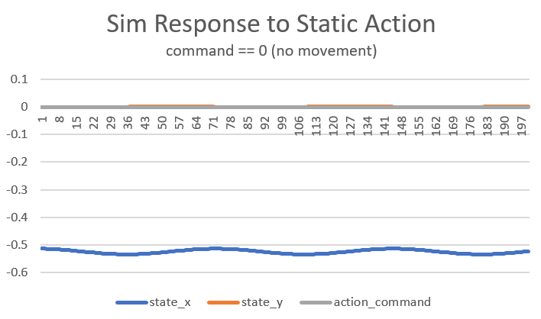
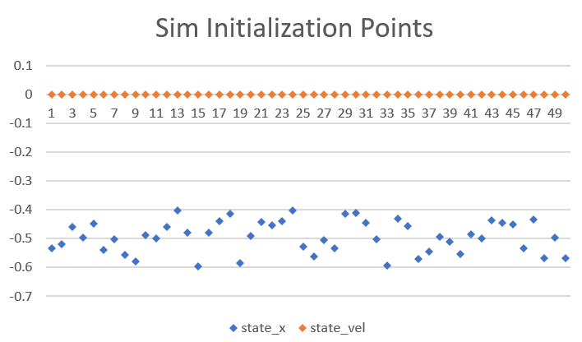
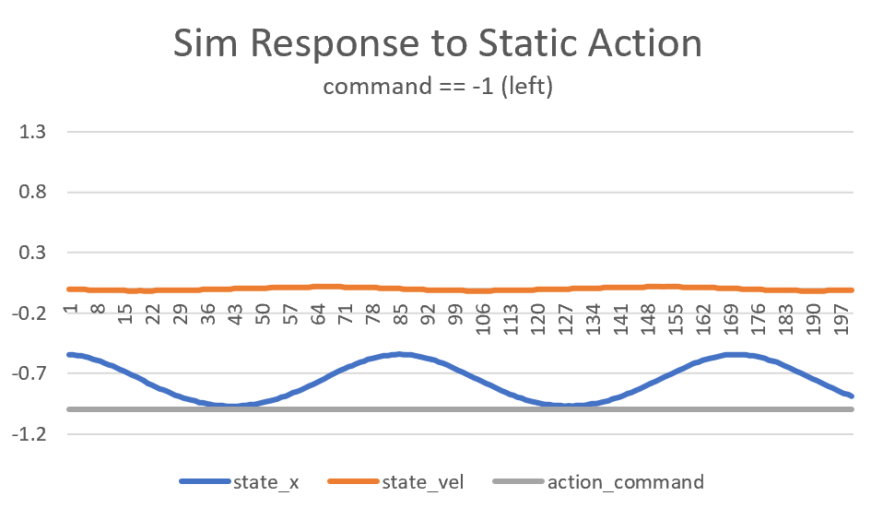
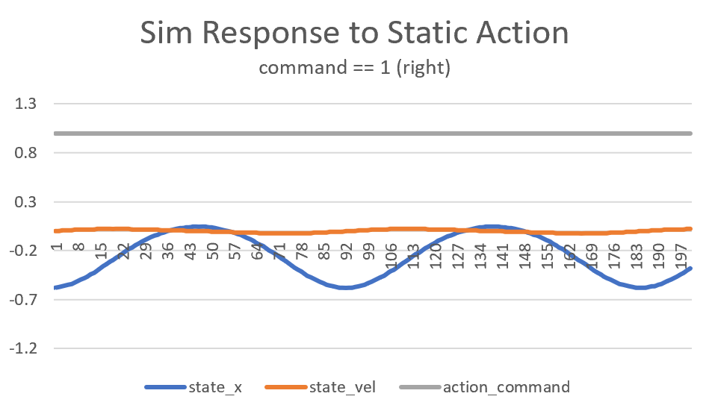
SIMULATION VALIDATION
Simulator Integration
Modified the MBA example for Cartpole to integrate a gym/python environment (simulator). Modified the RL methods to use the gym API (episode start, step, finish...). The simulation will run the Mountain Car gym example. Local connection was performed to validate connectivity.
Sim Overview
Markov Decision Process check: The relationship of states and actions is deterministic. (requires check)
Sim validation was performed locally to test that no errors are thrown, while capturing that our understanding of the sim is accurate.
Sim Validation: Sim initialization
The position of the cart gets initialized in the range [-0.6, -0.4]
The velocity of the cart is initialized at zero.
Sim Validation: No Action Response
The cart slides at low speed, when no action is applied.
Sim Validation: Action Direction Check & Goal Validation
Command = -1 makes the cart oscillate to the left: [-1, -½].
Command = 1 makes the cart oscillate to the right: [-½, 0].
The cart is not able to get to the goal (which is state_x = 0.45) with max right command.

Slide 5
BRAIN & MT DESIGN
Legend
Programmed concept
Learned concept
Programmed selector
Learned selector
RL-Readiness: Problem Statement
Section of interest | # | Comments & Proposals (pre-processors, post-processors, multi-concept, missing states/actions)
STATES | 2 | Since the number of states is not too large (< 15), we do not need to consider adding pre-processors nor multiconcept design. Nonetheless, we could still wonder if we really need velocity as a state to be successful? Pre-processor 1: Removing velocity as a state, and only providing cart position as Observable State.
ACTIONS | 1 | Since the number of actions is not too large (<10), we do not need to consider adding a post-processor nor multiconcept design.
SCENARIOS (configs) | 2 | All sim dynamics are static, except for cart position and noise (for domain randomization). Thus, we do not expect to need considering adding multi-concept, nor looking to add more states for monolithic approach. For domain randomization, we might want to consider lessons: Multi-lesson 1 - Proposal: Reduced/zero noise; Increase noise
OBJECTIVES | 2 | (1) Reaching the top, while (2) reach the top at minimum speed. We cannot think of a way to simplify the goals into smaller sections
OPERATING REGIONS | 2 | We could consider simplifying the problem based on the 2 operating regimes. Multi-concept 1 - Proposal: Learned concept – Get Momentum Reaching the goal by gaining momentum going from side to side; Learned concept – Stop Cart at Top Slowing down to reach the top with no speed; and Learned concept – Select One A concept to switch between gaining momentum, and slowing down
Monolithic Brain
Multi-concept 1: Operating Regions
input
Get Cart to Top
output
Get Momentum
output
Monolithic Brain w Pre-processor
input
Stop Cart at Top
output
input
Remove Speed
Get Cart to Top
output

Slide 6
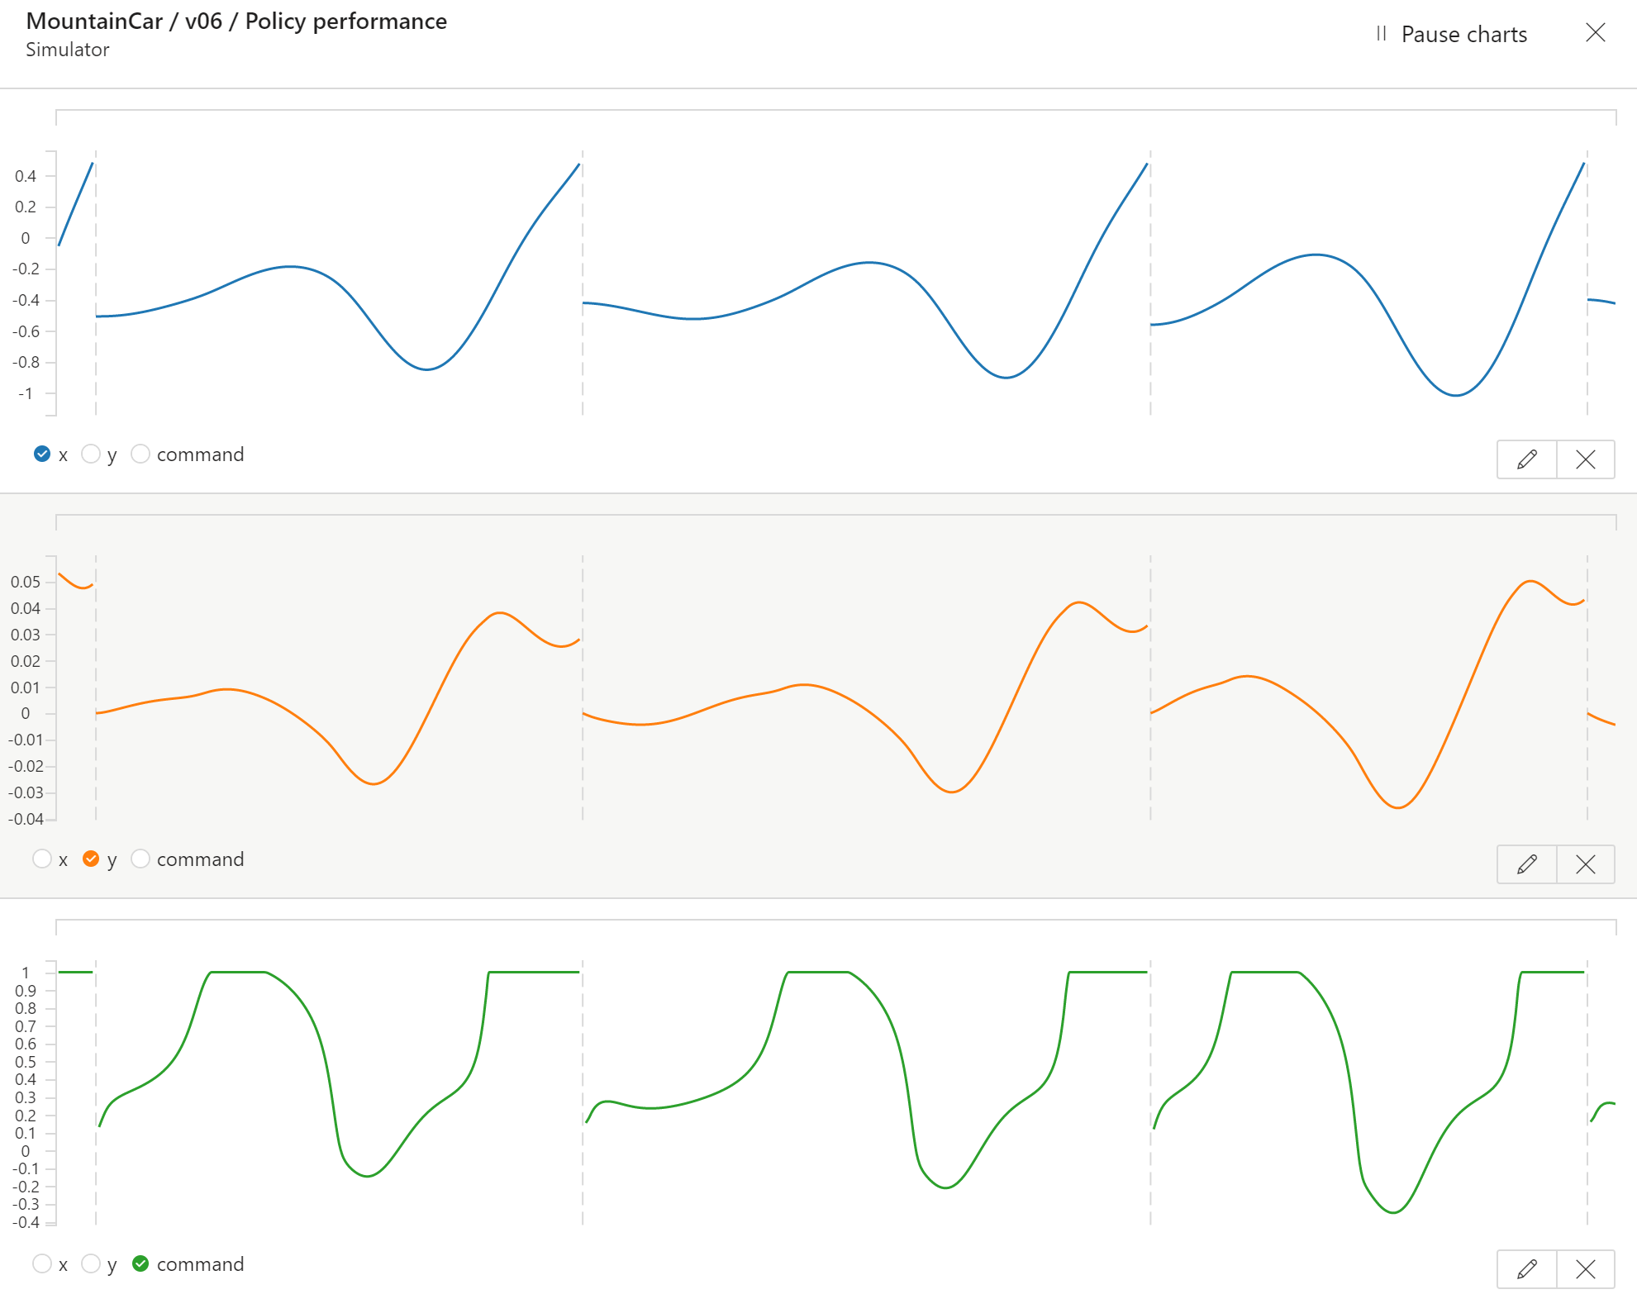
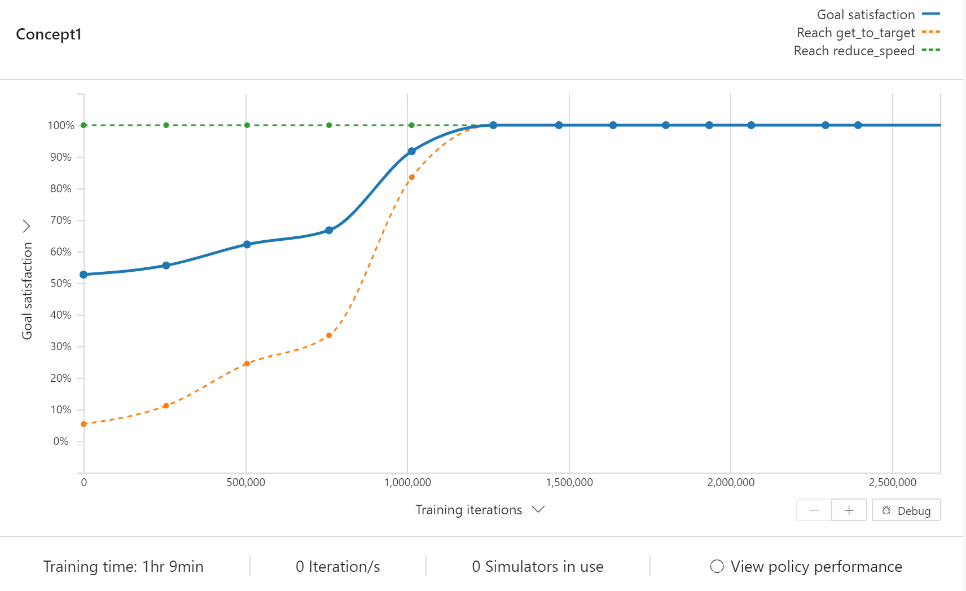
Monolithic Brain
RMS error (x distance to 0.45) | 6.36
# of iterations to meet objective | 175
Final Speed | 0.024
Champion it # / Total # of its trained (thousands) | 2,394 / 2,650
BEST BRAIN ASSESSMENT: Controlling the cart with 2 goals: reach the top, reach low speed
input
Get Cart to Top
output
Conclusion
The brain effectively controls the cart towards the top of the mountain. Unfortunately, the brain is not getting speed low when reaching the top.
No brain outperform this one. (lacks comparison against brain with domain randomization: brain might generalize better, same, or worse.)
Next Steps: It is worth looking into REACH sphere on both position and speed. That seems to be the best way to enforce simultaneously meeting both objectives.
Section of interest | # | Specs
STATES | 2 | x x_vel
ACTIONS | 1 | command
SCENARIOS (configs) | 1 | x gets randomized
OBJECTIVES | 2 | Reaching the top @ x >= 0.45 Reach low speed @ x_vel <= 0.001
OPERATING REGIONS | 1 | A single brain will control over the full state space
Exported Brain
(show a snippet of the brain outputs in CMD when queried locally)
(show data analysis on results)
Able to reach 100% goal satisfaction

Slide 7
EXPERIMENTATION
Experiment | RMS
Experiment 4: Controlling the cart with 1 goal: reach the top | 7.12
Experiment 5: Controlling the cart with 2 goals: reach the top, reach low speed | 6.36
Experiment 7: V5, Changing the speed goal to minimize (not reach) | 11.12
Experiment 9: V5, Without speed input as state | 14.1
Experiment 10: V9, Without speed input & 1 objective only | 14.5
Experiment 11 – BEST BRAIN V5, Adding noise to apply domain randomization | ??
Main learnings
[exp 4] The brain can easily learn to get the cart to the top in a short number of iterations.
[exp 5] The 2 reach goals didn’t work as expected. The top is reached, and the episode cut short. But the speed at top is not under our set objective (speed <= 0.001).
[exp 7] The minimize goal for speed didn’t help getting the speed lower. It made the cart oscillate from one side to the other of the mountain.
[exp 9 & 10] The speed is a required state to REACH-top objective. No brain was able to slightly learn beyond 10% goal satisfaction.
[exp 11] (missing analysis on Domain Randomization test)

Slide 8
APPENDIX
Experimentation Progress

Slide 9
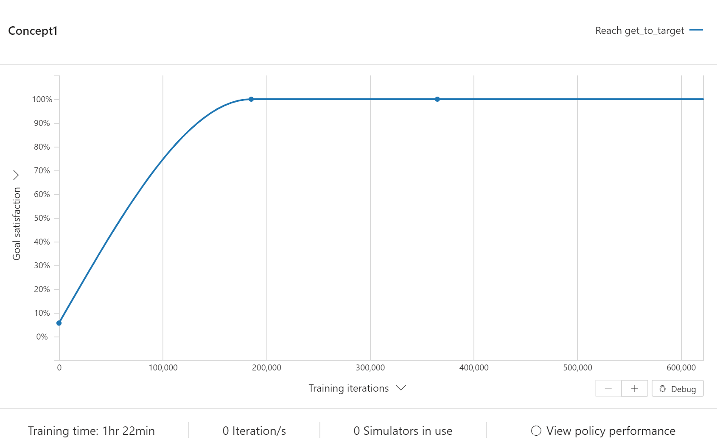
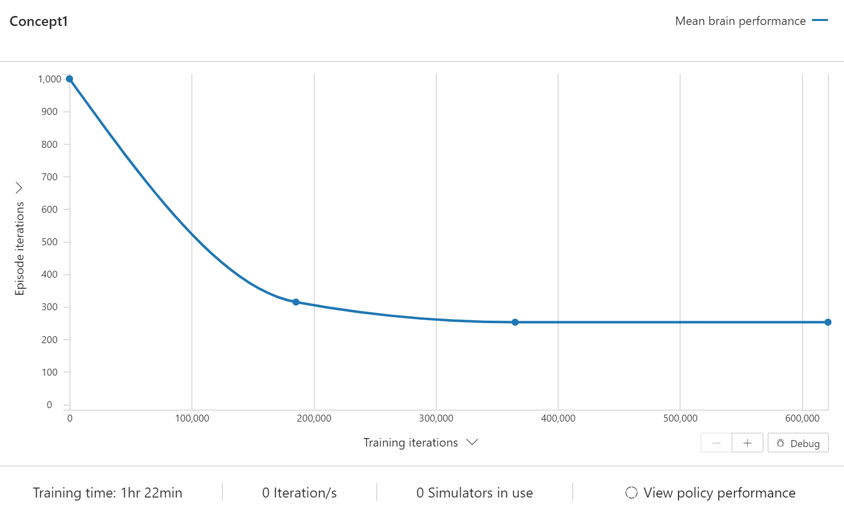
Monolithic Brain
RMS error (x distance to 0.45) | 7.12
# of iterations to meet objective | 252
Final Speed | 0.05
Champion it # / Total # of its trained (thousands) | 365 / 650
EXPERIMENT 4: Controlling the cart w 1 goal
input
Get Cart to Top
output
Section of interest | # | Specs
STATES | 2 | x x_vel
ACTIONS | 1 | command
SCENARIOS (configs) | 1 | x gets randomized
OBJECTIVES | 1 | Reaching the top @ x >= 0.45
OPERATING REGIONS | 1 | A single brain will control over the full state space
Hypothesis
To test viability of reaching our goal, we start simple: only trying to get to the top (no matter the speed of the cart).
If we can succeed with this goal, we will then try adding the restriction on speed.
Conclusion
The brain effectively controls the cart towards the top of the mountain.
Next experiment will add the speed limitation upon arrival.
Able to reach 100% goal satisfaction
Note, iterations get quickly reduced once the policy improves (we are using reach, which cuts the episode short)

Slide 10
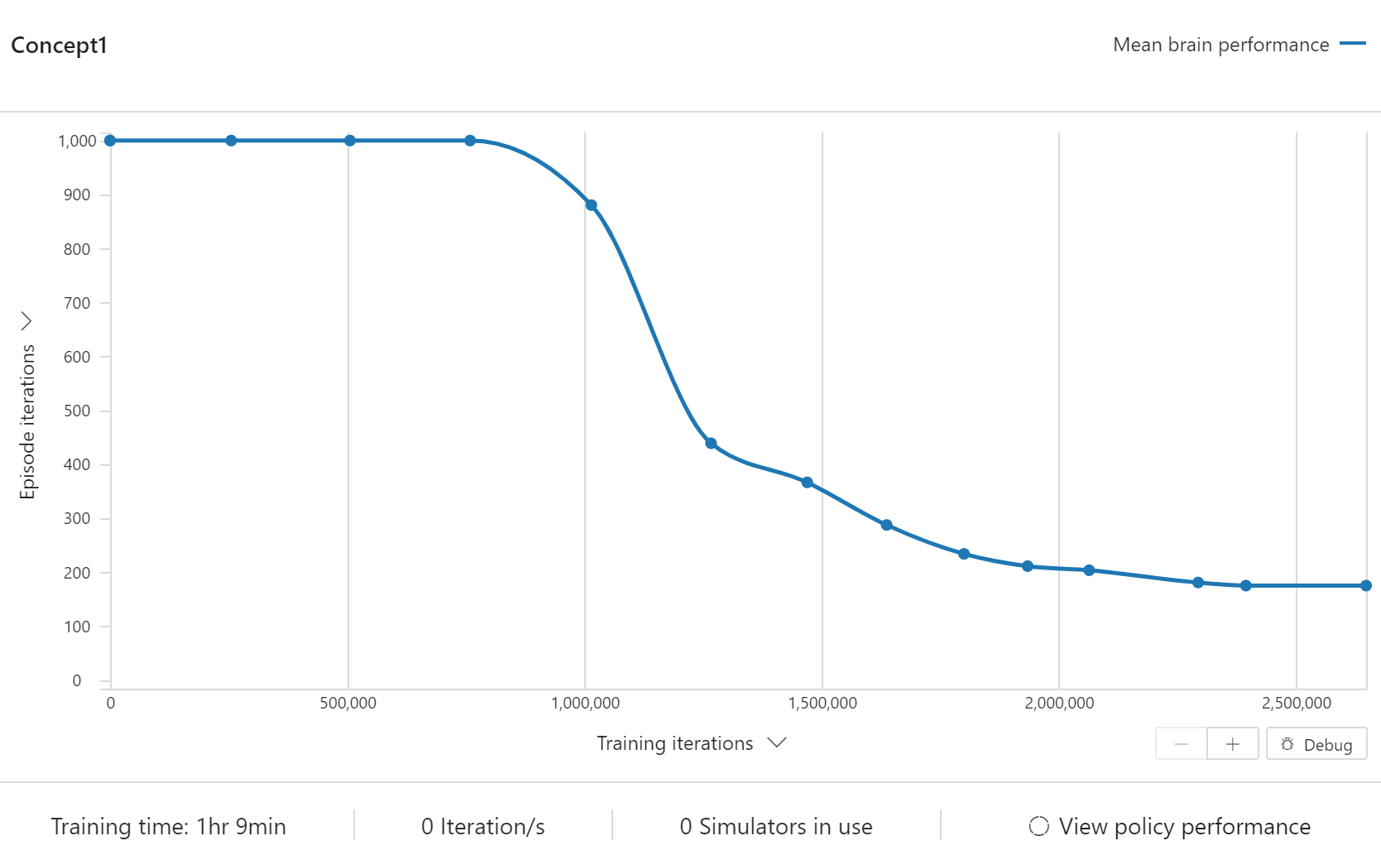
Monolithic Brain
RMS error (x distance to 0.45) | 6.36
# of iterations to meet objective | 175
Final Speed | 0.024
Champion it # / Total # of its trained (thousands) | 2,394 / 2,650
EXPERIMENT 5: Controlling the cart with 2 goals: reach the top, reach low speed
input
Get Cart to Top
output
Section of interest | # | Specs
STATES | 2 | x x_vel
ACTIONS | 1 | command
SCENARIOS (configs) | 1 | x gets randomized
OBJECTIVES | 2 | Reaching the top @ x >= 0.45 Reach low speed @ x_vel <= 0.001
OPERATING REGIONS | 1 | A single brain will control over the full state space
Hypothesis
If the brain was able to take the cart to the top, it might well be able to generalize to get it at low speed.
If it cannot, we will need to look for ways to simplify the problem.
Alternatively, we could synthetically add information, such as height, if needed.
Conclusion
The brain effectively controls the cart towards the top of the mountain. Unfortunately, the brain is not getting speed low when reaching the top.
To try getting minimal speed at top, we will be looking into MINIMIZE-speed instead of REACH-low_speed on our next experiment.
Able to reach 100% goal satisfaction
Note, iterations get quickly reduced once the policy improves (we are using reach, which cuts the episode short)

Slide 11
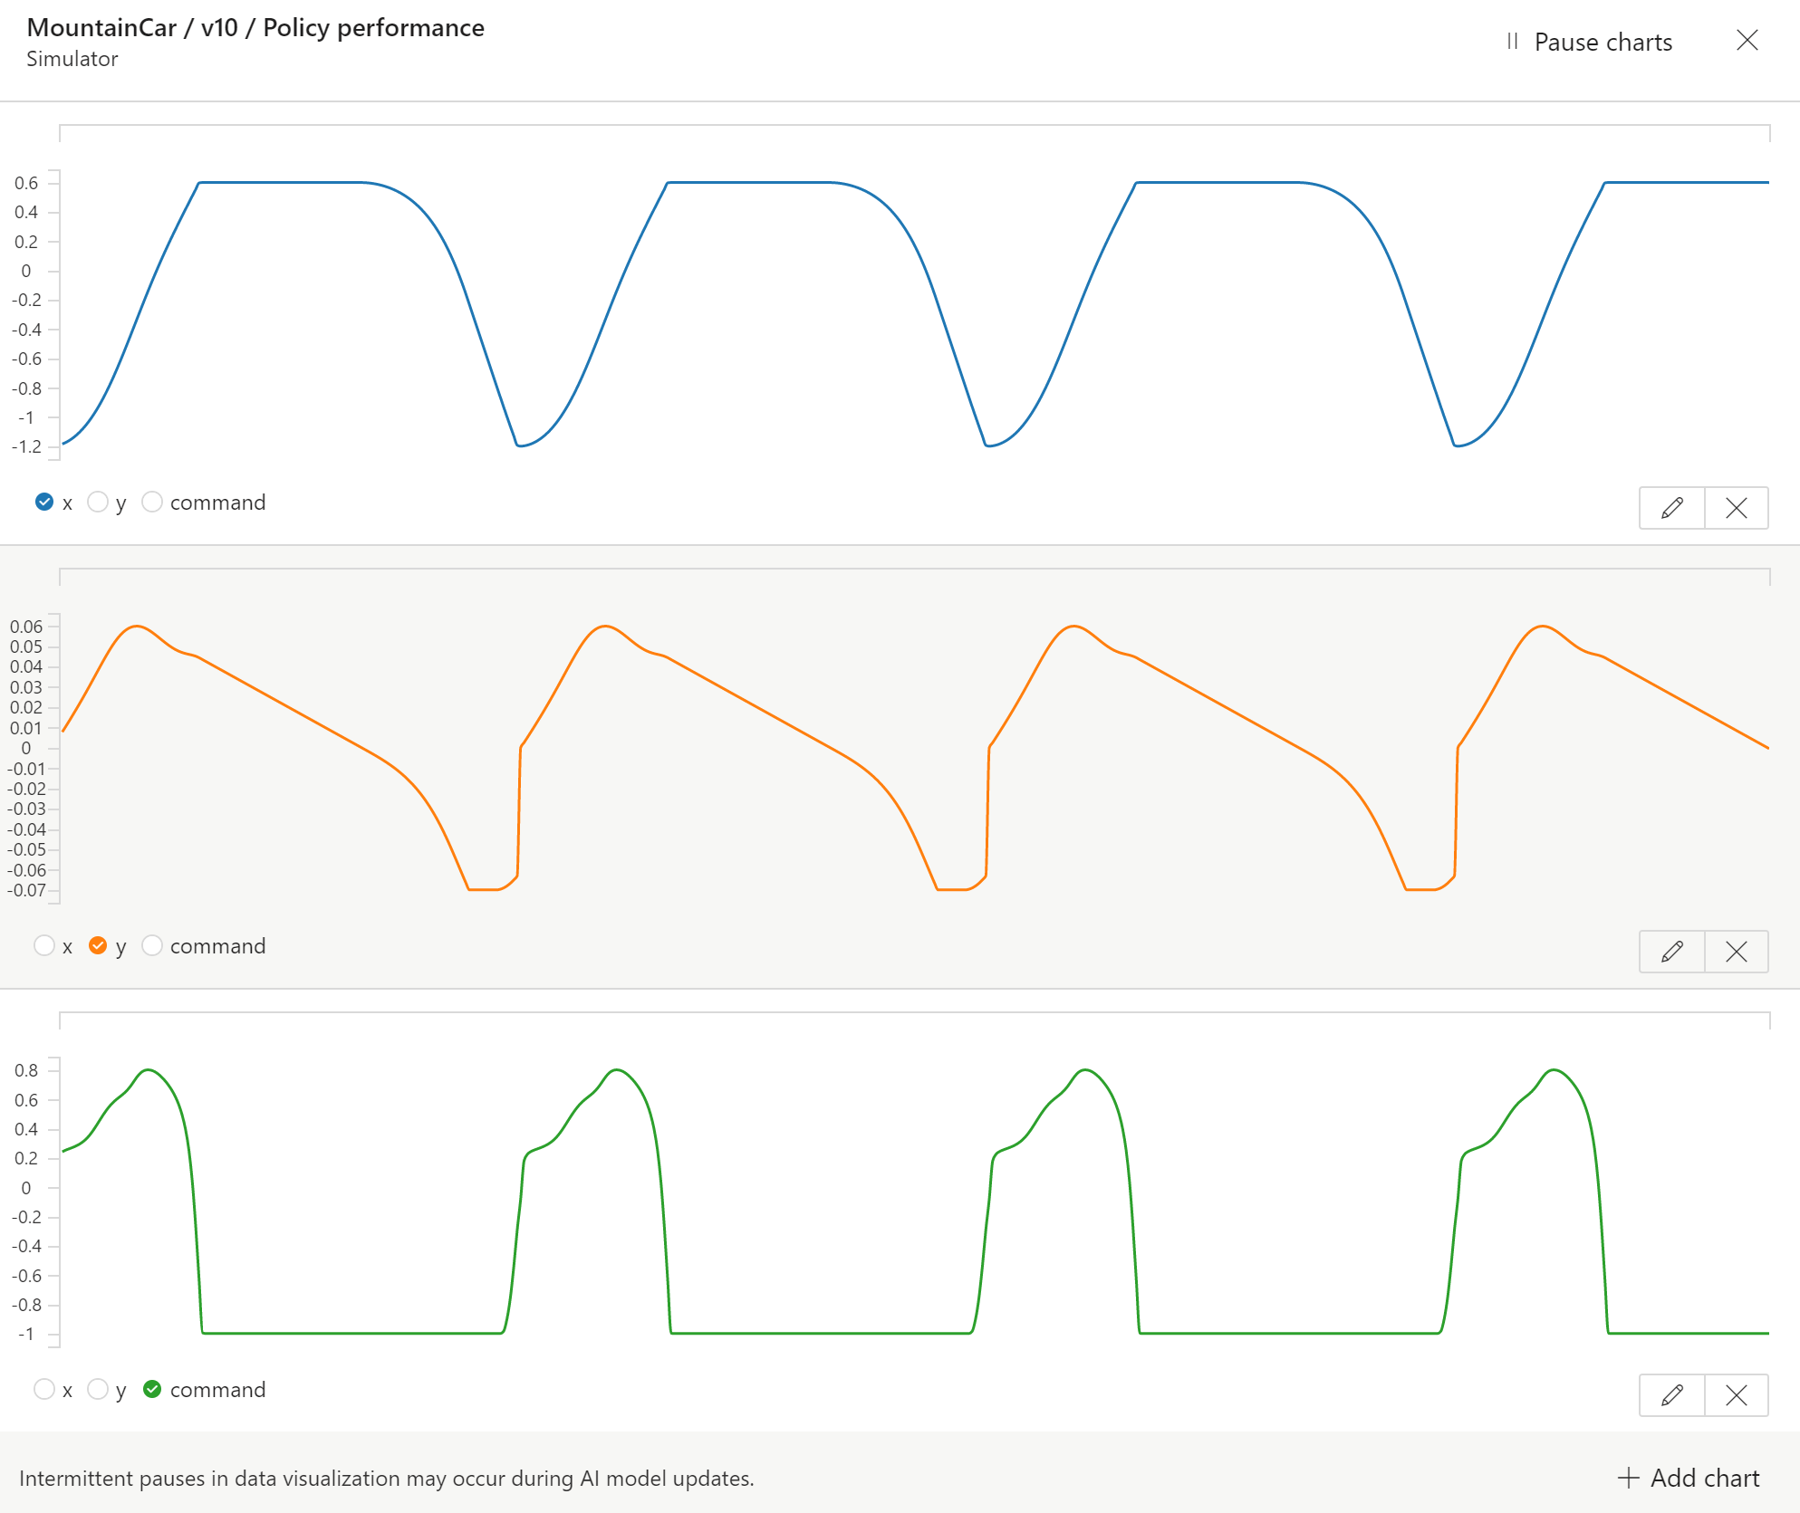
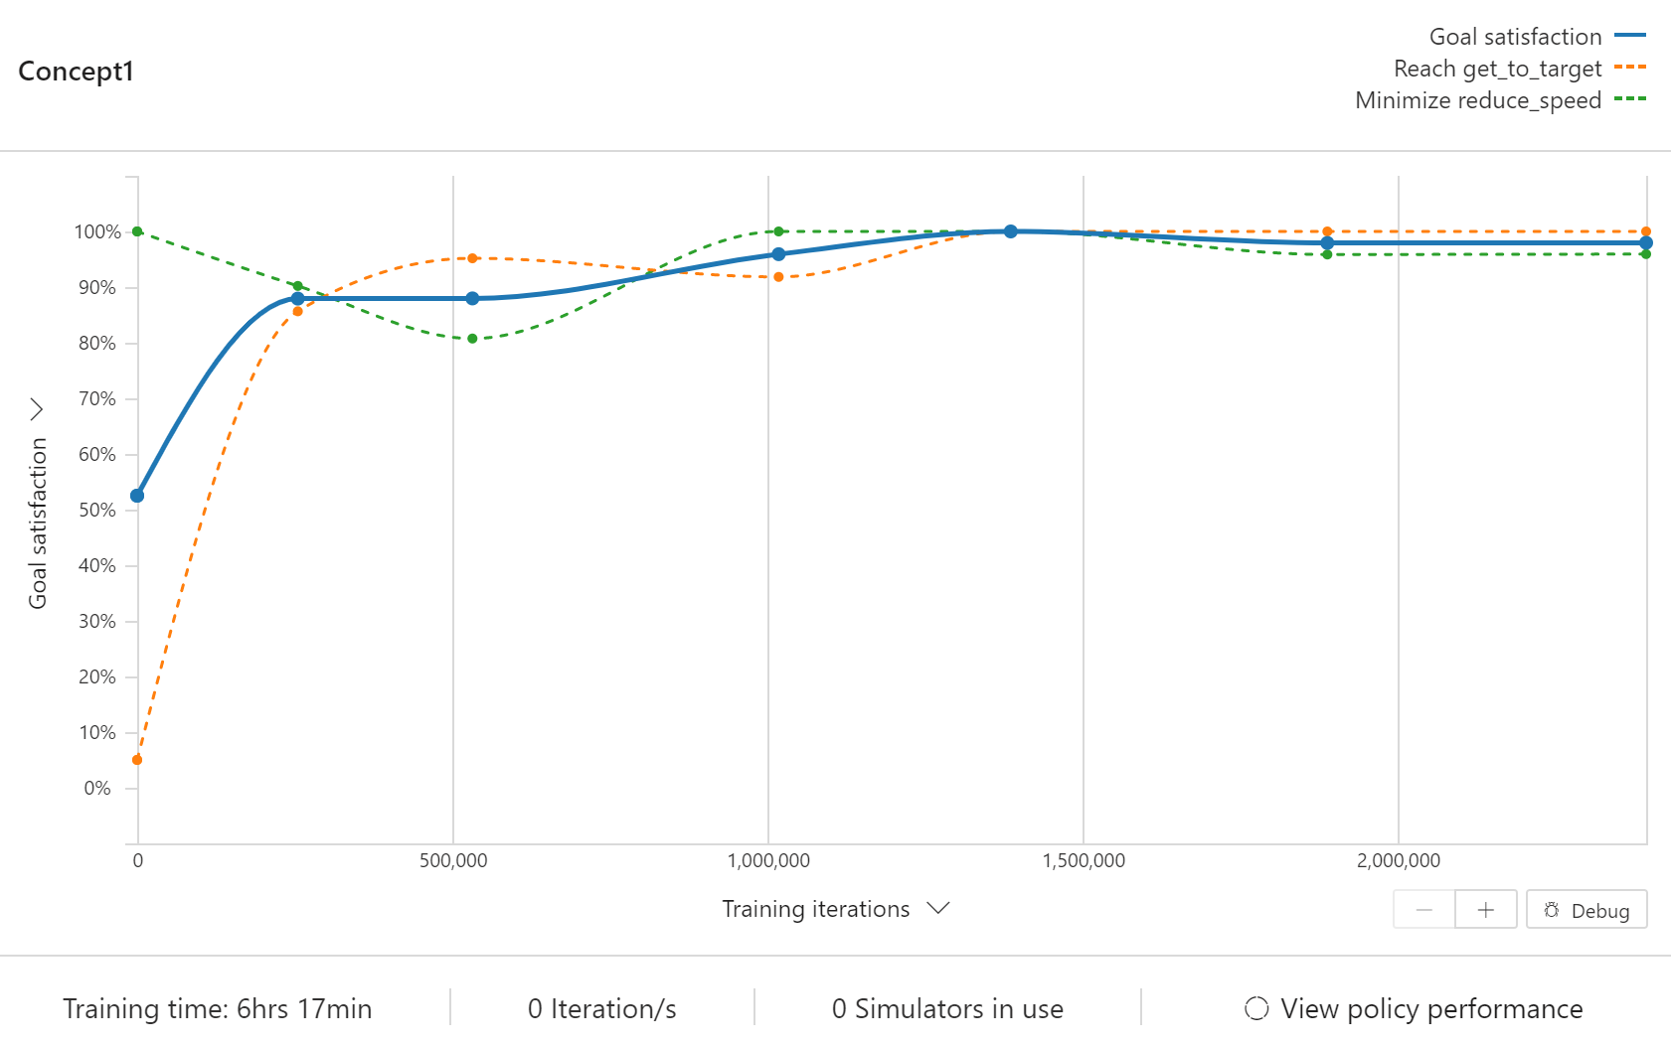
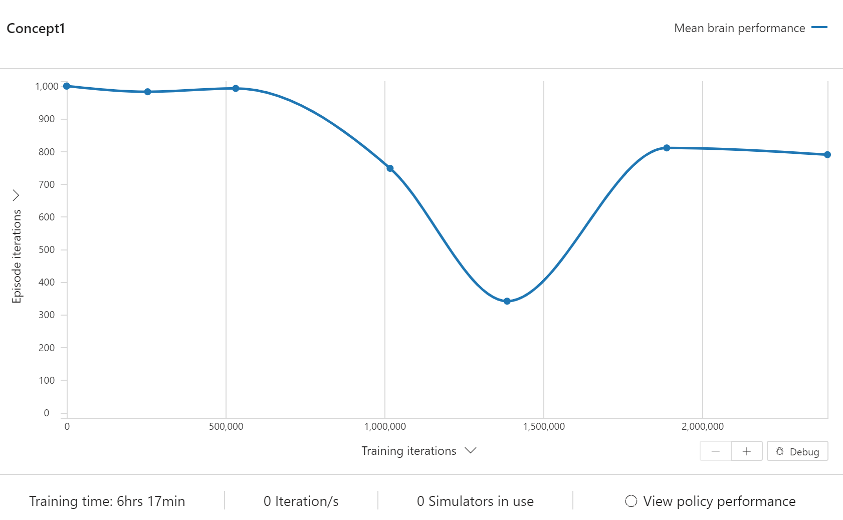
Monolithic Brain
RMS error (x distance to 0.45) | 11.12
# of iterations to meet objective | 1,000
Final Speed | 0.001
Champion it # / Total # of its trained (thousands) | 2,394 / 2,650
EXPERIMENT 7: V5, Changing the speed goal to minimize (not reach)
input
Get Cart to Top
output
Section of interest | # | Specs
STATES | 2 | x x_vel
ACTIONS | 1 | command
SCENARIOS (configs) | 1 | x gets randomized
OBJECTIVES | 2 | Reaching the top @ x >= 0.45 Minimize speed @ x_vel <= 0.001
OPERATING REGIONS | 1 | A single brain will control over the full state space
Hypothesis
If the brain was able to take the cart to the top, but not at low speed.
Now, we want to look into minimizing speed, to see if we can accomplish both goals.
Conclusion
The brain is not stopping the episode early. Opposite, it oscillates from top to bottom, and side to side of the mountain.
The combination of REACH + MINIMIZE is not working as expected.
Able to reach 100% goal satisfaction
Note, iterations get quickly reduced but suddenly increases (unexpected behavior with reach + minimize goals)

Slide 12
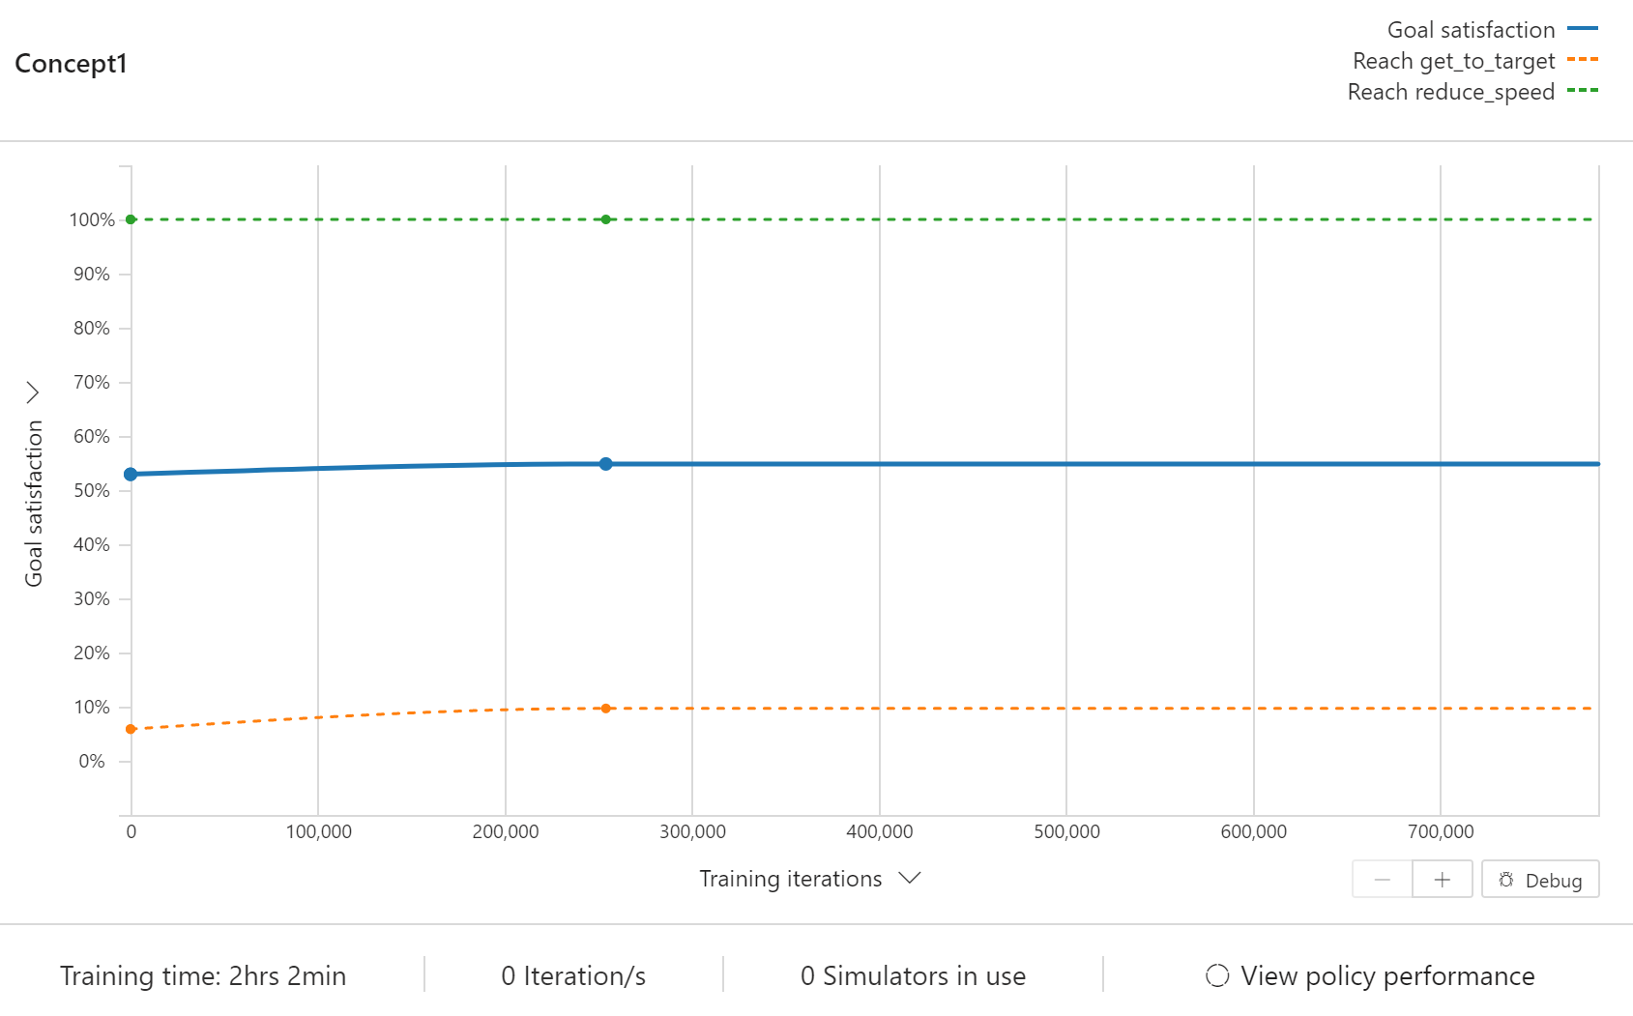
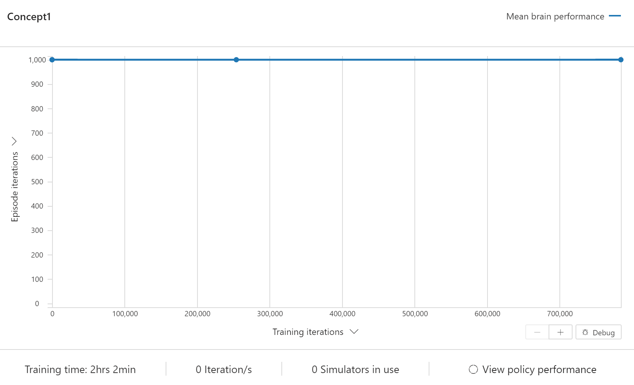
Monolithic Brain w Pre-processor
RMS error (x distance to 0.45) | 14.1
# of iterations to meet objective | 1,000
Final Speed | ---
Champion it # / Total # of its trained (thousands) | 254 / 780
EXPERIMENT 9: V5, Without speed input as state
input
Remove Speed
Get Cart to Top
output
Section of interest | # | Specs
STATES | 1 | x x_vel
ACTIONS | 1 | command
SCENARIOS (configs) | 1 | x gets randomized
OBJECTIVES | 2 | Reaching the top @ x >= 0.45 Reach speed @ x_vel <= 0.001
OPERATING REGIONS | 1 | A single brain will control over the full state space
Hypothesis
V5 was able to control the cart, and reach the top with a speed of ~0.024. For this experiment, we test if the brain can control the cart only based on position.
Our understanding of MDP (Markov Decision Process) tells us it might not be possible, since we want the cart to apply force in the direction of the speed. Not necessarily depending on the position only.
Conclusion
The brain is not able to learn the control needed. It learns to accomplish minimal speed, possibly by just turning the engines off. But it doesn’t learn to get to the top.
Based on the results, on our next experiment, we will test if the REACH-low_speed objective might be impeding the brain to learn the REACH-top objective.
The brain reaches 59% goal satisfaction
Note, iterations remain static (since the brain is not learning what it needs to do)

Slide 13
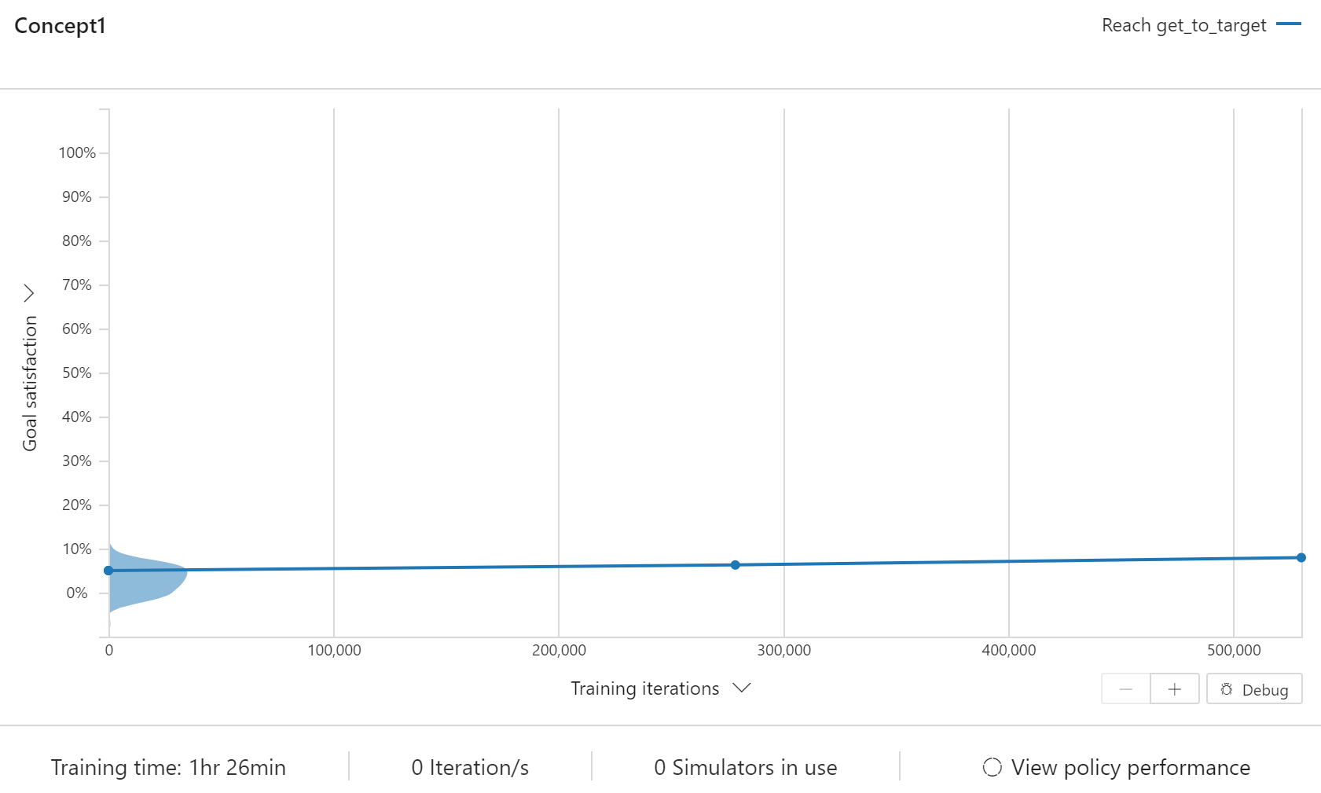
Monolithic Brain w Pre-processor
RMS error (x distance to 0.45) | 14.5
# of iterations to meet objective | 1,000
Final Speed | ---
Champion it # / Total # of its trained (thousands) | 278 / 530
EXPERIMENT 10: V9, Without speed input & 1 objective only
input
Remove Speed
Get Cart to Top
output
Section of interest | # | Specs
STATES | 1 | x
ACTIONS | 1 | command
SCENARIOS (configs) | 1 | x gets randomized
OBJECTIVES | 1 | Reaching the top @ x >= 0.45 Reach speed @ x_vel <= 0.001
OPERATING REGIONS | 1 | A single brain will control over the full state space
Hypothesis
By simplifying the objectives, we ensure the brain is not getting confused by the opposing objectives.
If the brain cannot control for REACH-top objective only, then we ultimately validate the MDP property is not being satisfied. The velocity is certainly a needed state.
Conclusion
The brain is not able to learn the control needed, for one objective only.
The speed is needed as a state to control this simulation.
The brain reaches 8% goal satisfaction
Note, iterations remain static for this example too (since the brain is not learning what it needs to do)

Slide 14
Monolithic Brain
RMS error (x distance to 0.45) | ??
# of iterations to meet objective | ??
Final Speed | ??
Champion it # / Total # of its trained (thousands) | ??
EXPERIMENT 11: V5, Adding noise to apply domain randomization
input
Get Cart to Top
output
Section of interest | # | Specs
STATES | 2 | x x_vel
ACTIONS | 1 | command
SCENARIOS (configs) | 1 | x gets randomized
OBJECTIVES | 2 | Reaching the top @ x >= 0.45 Reach speed @ x_vel <= 0.001
OPERATING REGIONS | 1 | A single brain will control over the full state space
Hypothesis
To better prepare for the sim2real gap, we want to expose the brain to an extra randomized variable: noise.
If the brain can effectively control the cart without 100% accurate metrics, it will be more resilient when applied to a real environment
Conclusion
Under Construction

